Slide 1
Review : Progressive Layered Extraction(PLE)
A Novel Multi-Task Learning (MTL) Model for Personalized Recommendations
Kaist GSDS Master’s Degree
20224314
Hyeongu Kang

Slide 2
CONTENTS
1. Summary of Paper
2. Pros & Cons
3. Research Idea
Define problem
Related work / prior method
Solving method
Experiment
Result
Strong point
Weak point

Slide 3
1. Summary of Paper
Define Problem
Related work / prior method
Solving Method
Experiment
Result

Slide 4
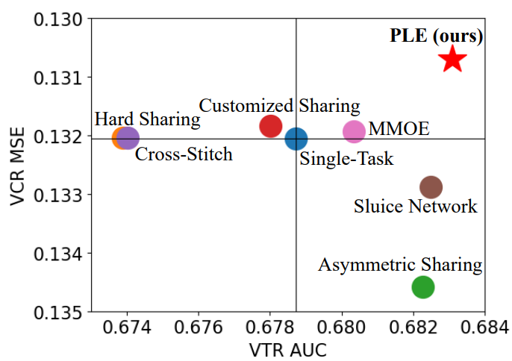
Define Problem
1. Summary
1) Negative Transfer
<Customized Gate Control(CGC) Model>
Common phenomenon in MTL for loosely correlated tasks
- Performance deterioration in MTL
2) Seesaw Phenomenon
Occur when tasks are 1) strongly correlated, 2) sample dependent
Improvement of one task leads to
performance deterioration of other tasks
Negative Transfer and Seesaw Phenomenon are
common problem of MTL. Solving both is important.

Slide 5
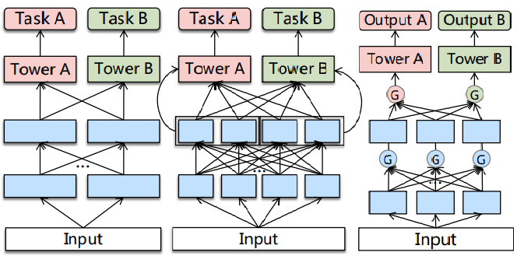
Related word / Prior method
1. Summary
<Cross-Stitch Network>
<Sluice Network>
<ML-MMOE>
Several methods of prior work of MTL
try to solve negative transfer, but neglect the seesaw Phenomenon

Slide 6
Related word / Prior method
1. Summary
<Cross-Stitch Network>
<Sluice Network>
<ML-MMOE>
<Property>
Learn weights of linear combinations to fuse representations from different tasks
→ Try to deal tasks conflict
But, representations are combined with the same static weights for all samples
→ Can’t address Seesaw Phenomenon
* Adaptive combinations of tasks is needed
By reviewing Cross-Stitch Network and Sluice Network,
we can check that adaptive combinations of tasks is needed

Slide 7
Related word / Prior method
1. Summary
<Cross-Stitch Network>
<Sluice Network>
<ML-MMOE>
<Property>
- Apply gate networks to obtain different fuse
weight of task difference among bottom expert
→ 1) Deal with negative transfer
and 2) optimize multiple objectives
- But MMOE not consider task correlation
→ Limit the performance of joint optimization
* There is no Task-specific / Task-shared concept
By reviewing ML-MMOE Model, Gate network is effective to fuse different tasks but we also consider task specific / shared concept

Slide 8
Related word / Prior method
1. Summary
Trial exist to apply Task specific/shared notion and find good network structure
1) MTAN
2) SNR framework
- First apply task-specific attention network
to fuse shared features selectively
- But different tasks still share the same
representation before fusion in attention
→ Tasks are mixed before consider
task specific / shared property
Control connections between sub-networks by binary random variables
Apply NAS to search for the optimal structure
→ Designed with certain simplified
assumptions and are not general enough
There are good trial in MTL, but all of prior methods are
not enough to become proper and general

Slide 9
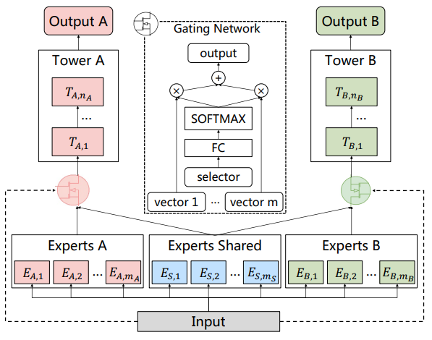
Solving Method – CGC
1. Summary
<Customized Gate Control>
<Customized Gate Control(CGC) Model>
Bottom : Shared & Specific expert modules
Gate : Fuse representation of specific experts and shared experts dynamically
Tower : Absorb knowledge from shared and specific expert through gate
CGC achieves more flexible balance between tasks and better deals with task conflicts and sample-dependent correlation

Slide 10
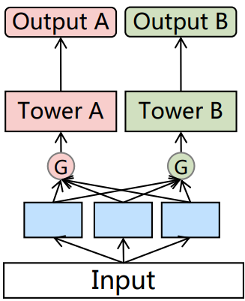
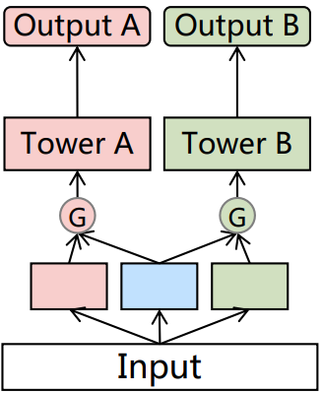
Solving Method – CGC
1. Summary
<MMOE vs CGC>
<MMOE Model>
<CGC Model>
There are two differences
1. Routing
MMOE connect all of experts
CGC connect each specific expert and shared expert
2. Bottom ingredient
MMOE only use task-specific expert
CGC use task-shared / task-specific experts
Specific expert 1
Specific expert 2
Specific expert 3
Specific expert 1
Shared expert
Specific expert 2
The difference of Routing Strategy and Bottom Ingressives allows CGC to well consider the difference and relationship among Tasks.

Slide 11
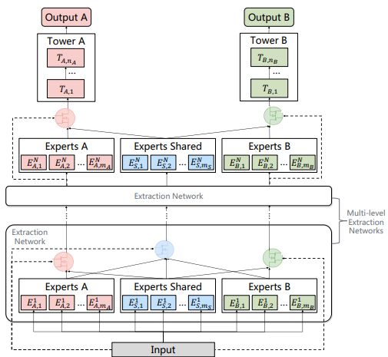
Solving Method – PLE
1. Summary
<Progressive Layered Extraction Model>
<Progressive Layered Extraction>
1. Hierarchy structure of information
- Extract higher-level shared information
- Gating network in higher-level take the fusion
results of gates in lower-level
2. Progressive separation routing
- Remove connection with other task-specific
- Consider high-level shared semantic representation
PLE shape out deeper semantic representations gradually with dividing whether the intermediate representations is shared or task-specific

Slide 12
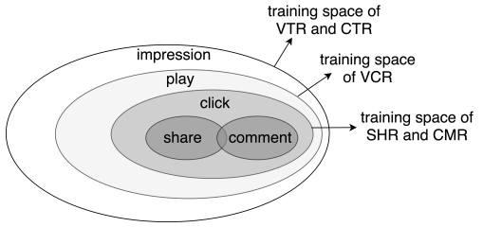
Solving Method – Joint Loss optimization
1. Summary
<Joint Loss Optimization for MTL>
1. Joint Representation
- Solve problem of heterogeneous samples space
ex) Due to sequential users action, share & comment
action are considered as heterogeneous
- Consider the union of sample space to train jointly
2. Introducing dynamic weight
Performance of MTL is sensitive to weight
Consider of weight tasks fluctuated with time
<Training Space of Different tasks>
By applying Joint Representation and dynamic weight, solve several issue in making joint optimization of MTL in practice

Slide 13
Experiment
1. Summary
Data
Industrial dataset from Tencent. 46,926 mil users / 2,682 mil video, 0.996 billion samples in Dataset
Public Dataset : Synthetic Data, Census-income Dataset, Ali-CCP Dataset
Baseline model
Single model : Normal, Symmetric, Customized sharing, Cross-stitch, Sluice Network, MMOE
Multitask model : ML-MMOE
Test Case
1) Degree of Correlation between Variables(Strong or Loose)
2) Single-task model on Online A/B test
3) Single / Multi tasks
4) Expert Utilization Analysis between MMOE & PLE
Estimation
Calculate AUC & MSE of each Indicator(main on VCR, VRT) + MTL Gain
* MTL Gain : Quantitively evaluate the benefit of Multi-task learning over the single-task model

Slide 14
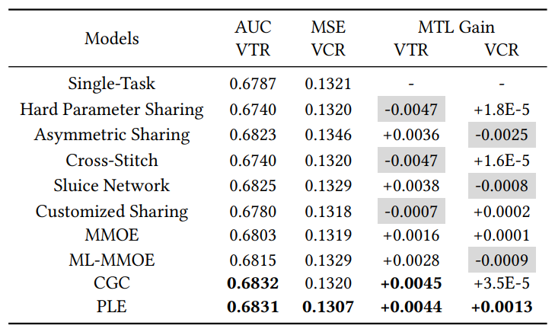
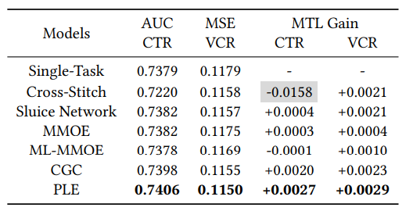
Result
1. Summary
<Strong Correlation between Variable>
<Loose Correlation between Variable>
identify seesaw phenomenon exist
PLE’s performance is really close to SOTA-method or over-performance
Even correlation between variables is loose, PLE overscore SOTA-MTL method
Regardless relation between variable is strong or loose,
PLE overscore for most aspect of test then SOTA-MTL method

Slide 15
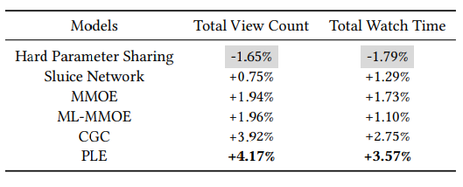
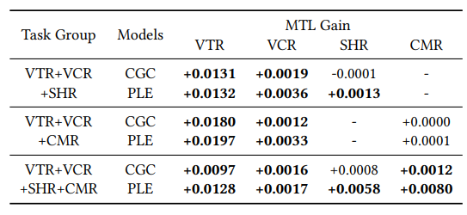
Result
1. Summary
<Performance on Online A/B test>
<MTL gain of CGC & PLE on Multi Tasks>
Shows improvement of MTL models over the single-task model on Online total view count & watch time
CGC & PLE show the benefits of promoting task cooperation
PLE outperforms CGC in all cases
PLE delivers the best performance in real-world online applications
And it also proved the positive influence of Multi-task learning.

Slide 16
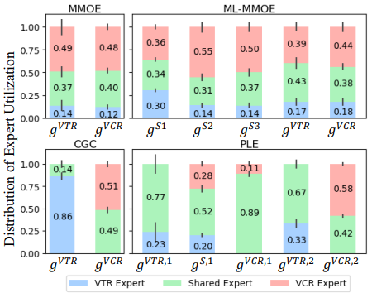
Result
1. Summary
<Expert Utilization in Gate-Based Models>
MMOE’s routing is not Generalization of CGC’s
Distribution between MMOE & ML-MMOE is similar
But distribution of CGC& PLE is significantly different.
→ CGC’s structure helps achieve better differentiation & MMOE hard to converge CGC without prior knowledge
Higher-level deeper representation is Valuable
PLE performs better than CGC
Shared expert in PLE have larger influence
→ Show that high-level deeper representation is valuable
Expert Utilization show that PLE is good model than ML-MMOE & Higher-level deeper representation is Valuable in MTL

Slide 17
2. Pros & Cons
Strong point
Weak point

Slide 18
Strong point
2. Pros & Cons
1. Novel Idea(Contribution)
2. Good Motivation
3. Reproducible
4. Convincing Results

Slide 19
Novel Idea(Contribution)
2. Pros & Cons
1. Specify the problem “Seesaw Phenomenon” and why this happen.
- Improvement of one task often leads to performance degeneration of the other task
- “Seesaw Phenomenon” occurs when tasks are strongly correlated and especially sample dependent
2. Solving “seesaw Phenomenon” & “Negative transfer” and achieve SOTA’s grade
Propose CGC and Information routing strategy
Propose Gating Network in Higher-level extraction Network
3. Show that considering all of relation among tasks not guarantee optimal result
- MMOE’s gate connect all of tasks but, PLE only connect each specific tasks & shared tasks
- PLE overscore MMOE in most case.
- There is significant difference between distribution of PLE and ML-MMOE’s expert Utilization

Slide 20
Good to Motivation
2. Pros & Cons
1. Solving common problem of MTL : “Negative transfer” & “Seesaw Phenomenon”
- Since ‘Negative transfer’ frequently occurs in loosely correlated multi tasks.
- On the other side, ‘Seesaw Phenomenon’ frequently occurs in strongly correlated multi tasks, especially sample-dependent situation
→ In most case of MTL, one of problem easily occurs
2. 0.1% improve of AUC/MSE contributes significant improvement to online metric
VCR’s MSE decrease 1.1% & VTR’s AUC increase 0.7%
It result in increase of 4.17% Total view count & 3.57% of Total watch time
in single-task model on Online A/B test

Slide 21
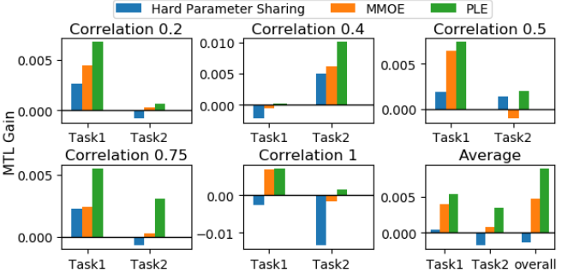
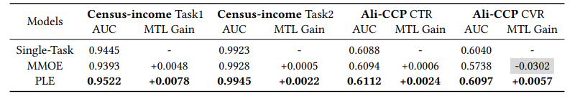
Reproducible
2. Pros & Cons
1. The PLE method is also effective in Public Data.
- 1.4 mil samples of Synthetic Data are used
- Prove that PLE consistently performs best
for both tasks across different correlations
- Achieves 82.7% increase in MTL gain
over MMOE on average
- PLE overscore MMOE in public data of Census-income Dataset and Ali-CCP Dataset
<MTL gain on Synthetic Data>
<Experiment Results on Census-income and Ali-CCP Dataset>

Slide 22

Convincing Results
2. Pros & Cons
1. The PLE method ensured the best performance in most cases with large data
- Using 1 billion samples of Tencent Video recommendation dataset
Show that there is 'seesaw phenomenon' and prove that PLE can solve this problem.
Regardless of the correlation degree between tasks, it brought the best performance.
Increase Total view count and Total Watch Time by 4.17% and 3.57% respectively in the online A/B test.
<Strong Correlation between Variable>
<Loose Correlation between Variable>
<Performance on Online A/B test>

Slide 23
Weak point
2. Pros & Cons
1. Additional considerations arising from the introduction of shared experts
1) Calculation volume increase due to updating value
2) Calculation volume increase due to parameter increase
3) Selection problem about appropriate shared expert
2. Lack of explanation
1) Does really 0.1% increase of AUC / MSE statistically meaningful?
2) Why use different metric(AUC/MSE) in figure 3?

Slide 24
Weak point
2. Pros & Cons
1. Additional considerations arising from the introduction of shared experts
1) Calculation volume increase due to updating value
- Parameters of Shared experts are affected by all tasks
while parameters of task-specific expert are only affected by the corresponding specific task
2) Calculation volume increase proportionally with the number of tasks
- Size of the network parameters grows proportionally with respect to the total number of tasks
- When there are n independent tasks, the number of cases of shared experts become very large.
Even if shared experts only consider relationship between each two tasks,
the number of shared experts required is n(n-1)/2.
3) Selection problem about appropriate shared expert
- Human resource is needed to select appropriate shared experts

Slide 25
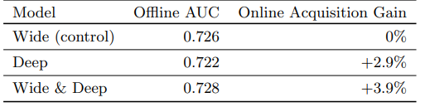
Weak point
2. Pros & Cons
2. Lack of explanation
1) Does really 0.1% increase of AUC / MSE statistically meaningful?
- Paper only mention “It is worth noting that 0.1% increase of AUC or MSE contributes significant improvement to online metrics in our system, which is also mentioned in [4, 6, 14].”
- [14] : “This is a significant improvement for industrial applications where 0.1% AUC gain is remarkable.”
- [6] : use as a reason of [4] such as,
“Wide & Deep improves AUC by 0.275% (offline) and the improvement of online CTR is 3.9%.”
- But when check [4] Cheng et al,
[6] only describes the transition from
the base model(Wide) to the Wide & Deep model,
but does not explain the case of the Deep model
in which the AUC has decreased but the
Online Acquisition Gain has increased.
2) Why use different metric(AUC/MSE) in figure 3?
<Offline & Online metrics of different models>
* Figure from [4] Cheng et al

Slide 26
3. Research Idea

Slide 27
3. Research Idea
1.Reduce the amount of calculation
1) Introducing Dropout
2) Check applicability of parallel and distributed MTL
3) Dimension reduction about domain of tasks
2. Expand to multi-domain learning
3. Combination of multi view/domain/tasks
4. More deep hierarchy PLE Model

Slide 28
Q n A

